Slide 1
Regression
Mr. Sunanda Das
Assistant Professor, Dept. of CSE, KUET

Slide 2
Simple linear regression is a linear regression model with a single explanatory variable.
It concerns two-dimensional sample points with one independent variable and one dependent variable.
Finds a linear function (a non-vertical straight line) that, as accurately as possible, predicts the dependent variable values as a function of the independent variables.

Slide 3
Objectives
Establish if there is a relationship between two variables.
Examples: Income and Spending
Forecast new observations
Can we use what we know about the relationship to forecast unobserved values?
Examples: What will be the sales over the next quarter?

Slide 4
Variables
Dependent Variable:
This is the variable whose values we want to explain or forecast
We denote it as y
Independent variable:
This is the variable that explains the other one.
We denote it as X.

Slide 5

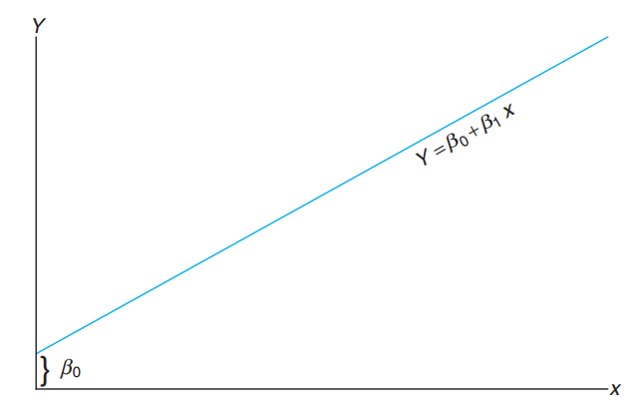
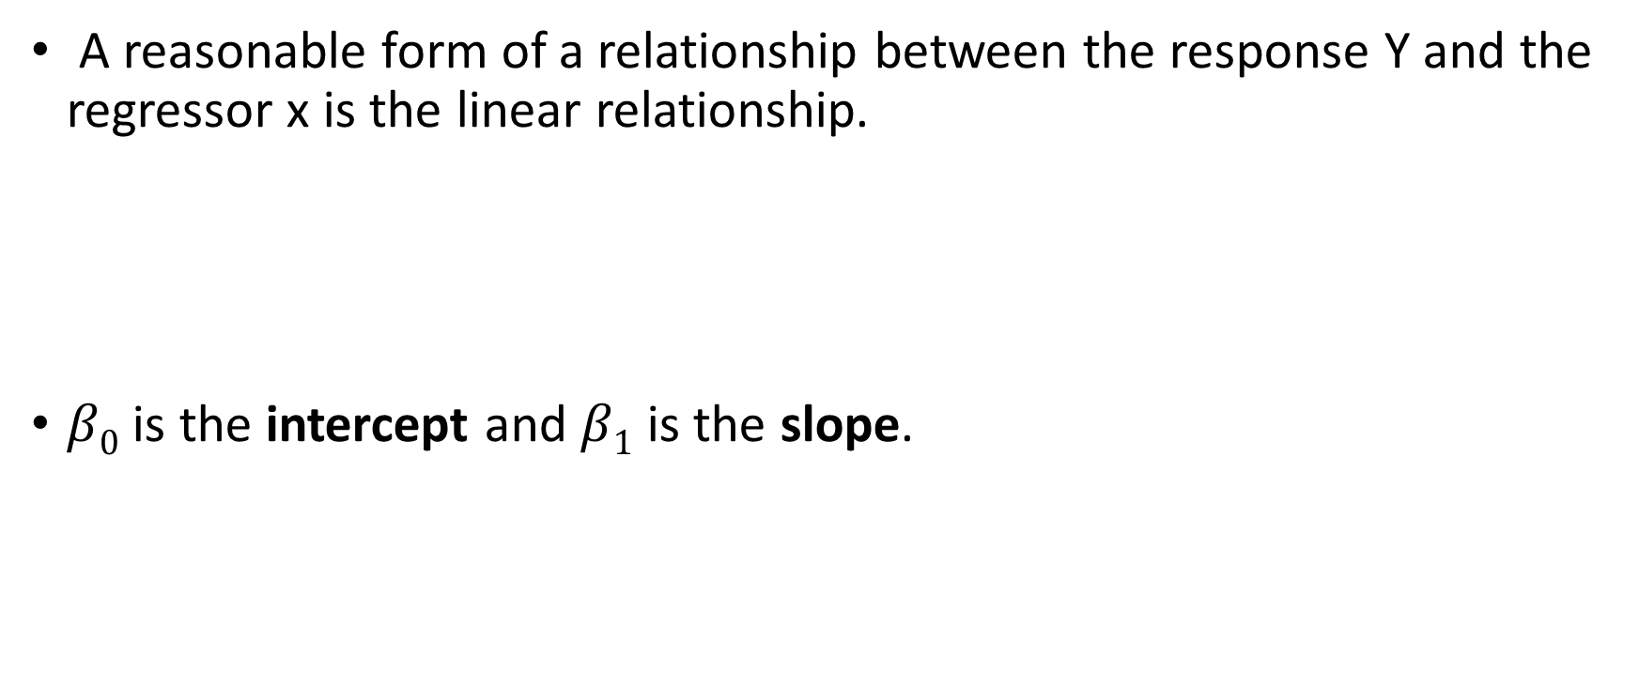
Regression Model
A reasonable form of a relationship between the response Y and the regressor x is the linear relationship.
$β0$ is the intercept and $β1$ is the slope.

Slide 6

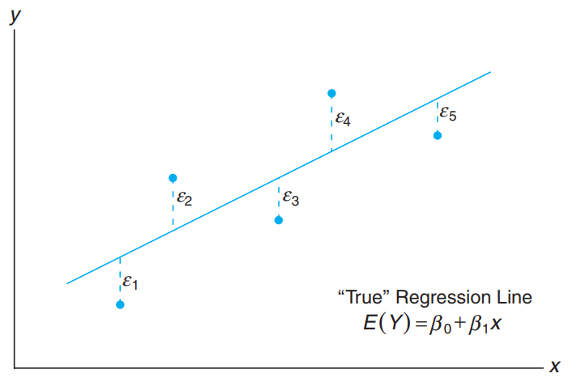

But the world is not linear
The quantity $ε$, often
called a random error or
random disturbance

Slide 7

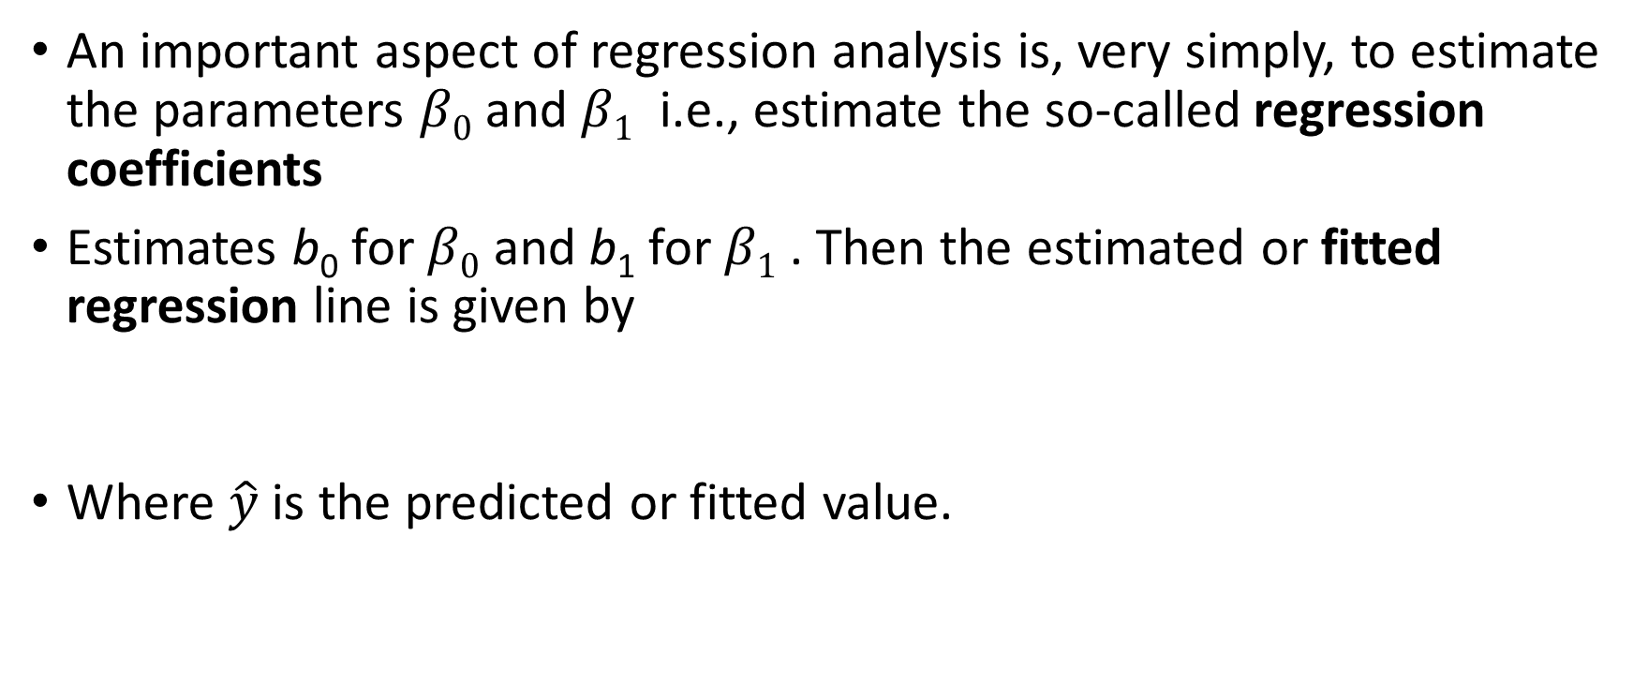
The Fitted Regression Line
An important aspect of regression analysis is, very simply, to estimate the parameters $β0$ and $β1$ i.e., estimate the so-called regression coefficients
Estimates b₀ for $β0$ and b₁ for $β1$ . Then the estimated or fitted regression line is given by
Where $\hat{y}$is the predicted or fitted value.

Slide 8
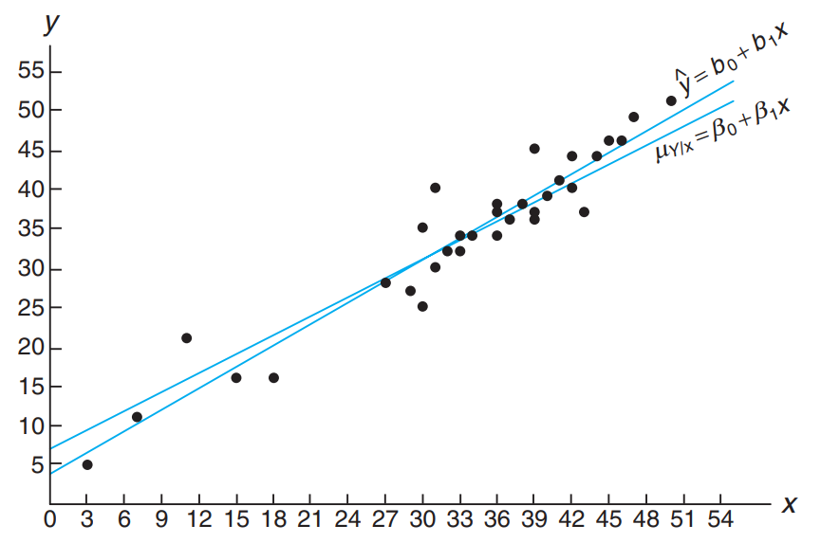

Slide 9
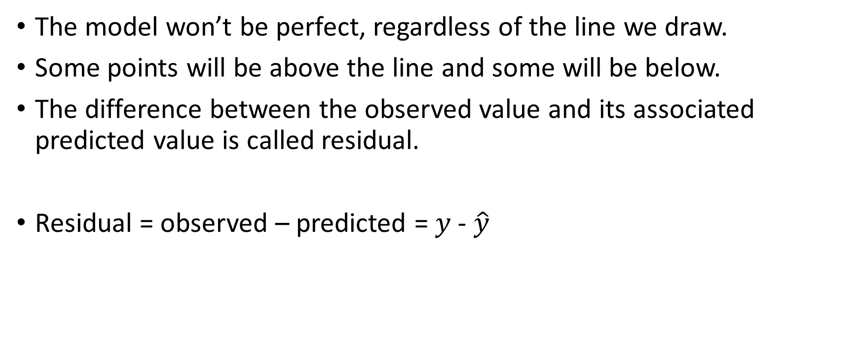
Residual: Error in Fit
The model won’t be perfect, regardless of the line we draw.
Some points will be above the line and some will be below.
The difference between the observed value and its associated predicted value is called residual.
Residual = observed – predicted = $y$- $\hat{y}$

Slide 10


Sum of Square Error
The residual sum of squares is often called the sum of squares of the errors about the regression line and is denoted by SSE.
Differentiating SSE with respect to b₀ and b₁

Slide 11

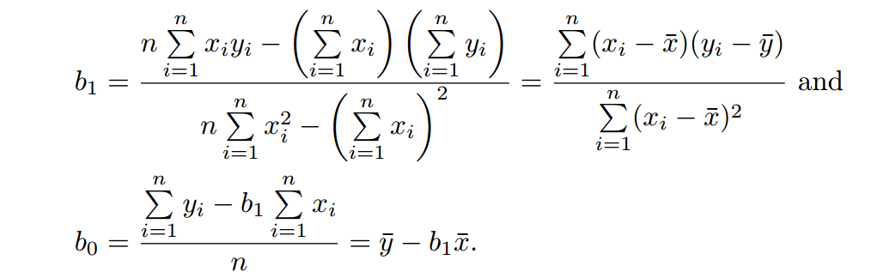
Setting the partial derivatives equal to zero and rearranging the terms

Slide 12
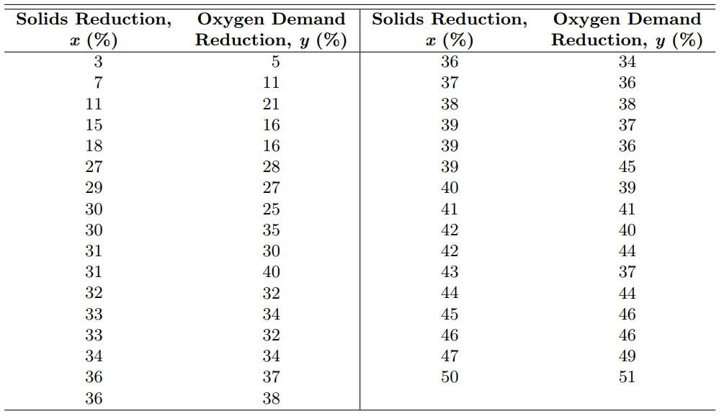

Slide 13
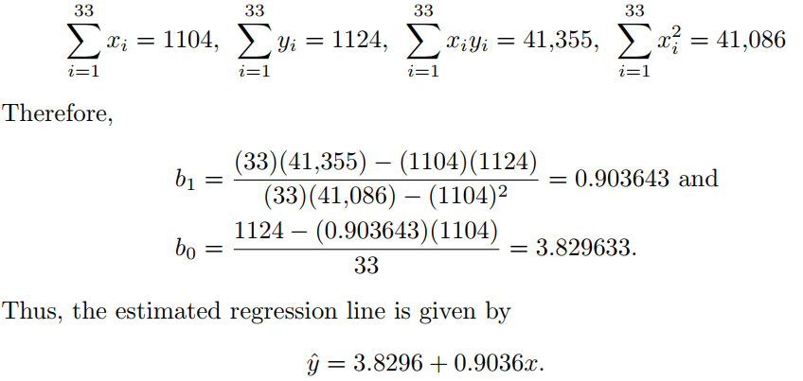

Slide 14



A Measure of Quality of Fit: Coefficient of Determination
Measure goodness of fit of the estimated model.
This quantity is a measure of the proportion of variability explained by the fitted model.
The error sum of squares
Total corrected sum of squares

Slide 15
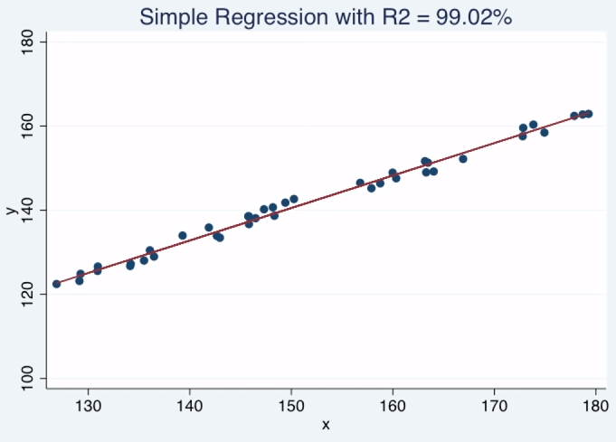
R² = 0 (the model does not explain anything)
R² = 1 (the model explains everything)
R² = % of total variation explained by the variation in x

Slide 16
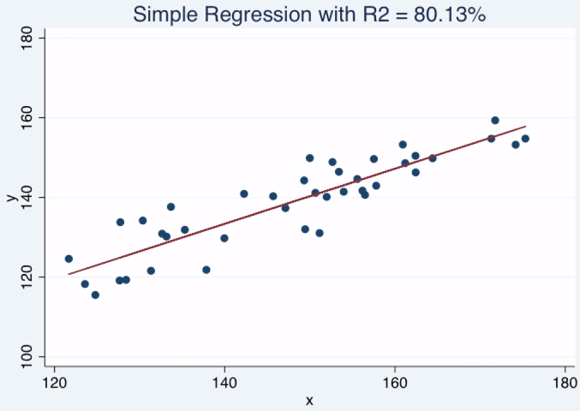
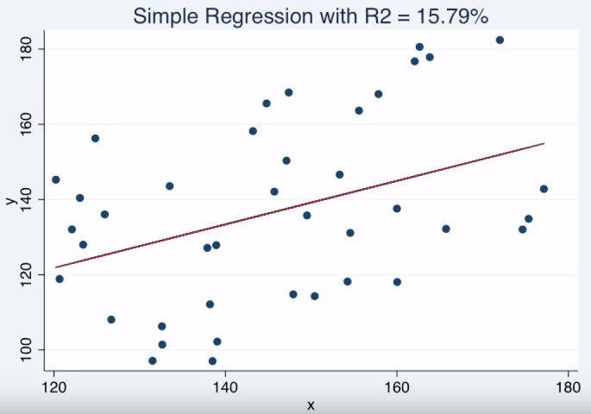

Slide 17
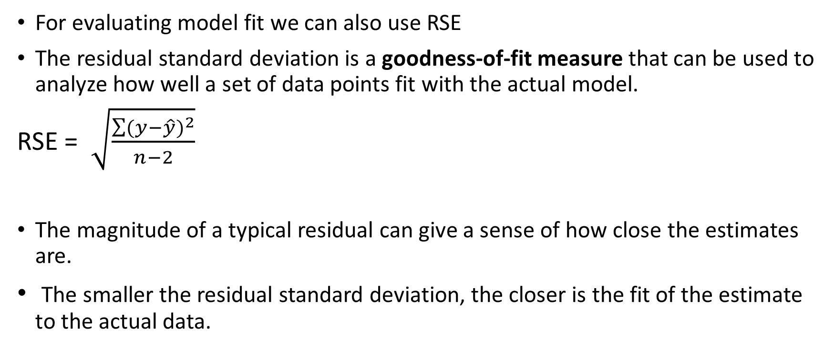
Residual Standard Error (RSE)
For evaluating model fit we can also use RSE
The residual standard deviation is a goodness-of-fit measure that can be used to analyze how well a set of data points fit with the actual model.
RSE = $\sqrt{\frac{\sum{{(y−\hat{y})}^{2}}}{n−2}}$
The magnitude of a typical residual can give a sense of how close the estimates are.
The smaller the residual standard deviation, the closer is the fit of the estimate to the actual data.

Slide 18
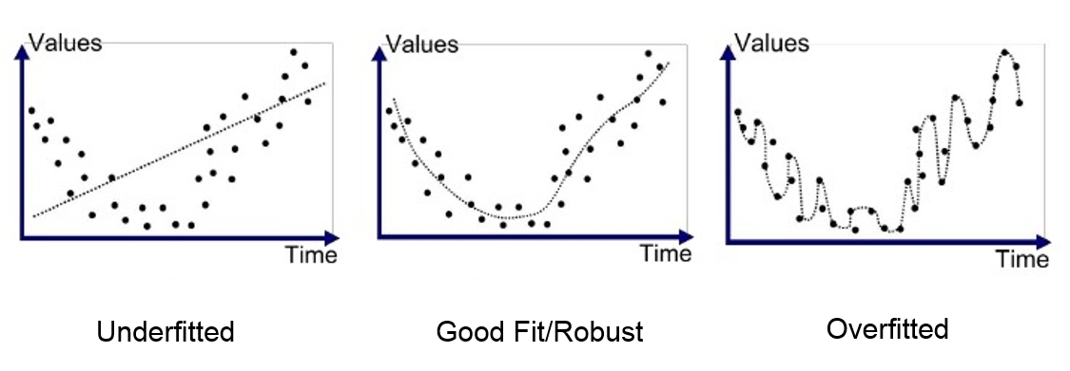
Overfit and Underfit

Slide 19
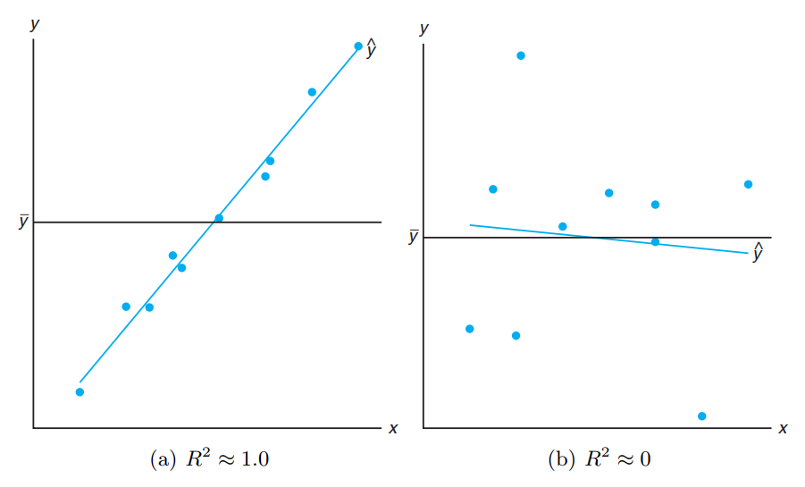

Pitfalls in the Use of R²

Slide 20
What is an acceptable value for R²?
some scientific phenomena lend themselves to modeling with more precision than others.
Adding additional terms to the model (e.g., an additional regressor)
Decreases SSE and thus increases R² (or at least does not decrease it).
This implies that R² can be made artificially high by an unwise practice of overfitting (i.e., the inclusion of too many model terms).

Slide 21
Regression to the mean(RTM)
This is purely a statistical phenomenon.
Also known as reversion to the mean or reversion to the mediocrity.
If a variable
Is extreme on its first measurement
It will tend to be closer to the average on a second measurement

Slide 22
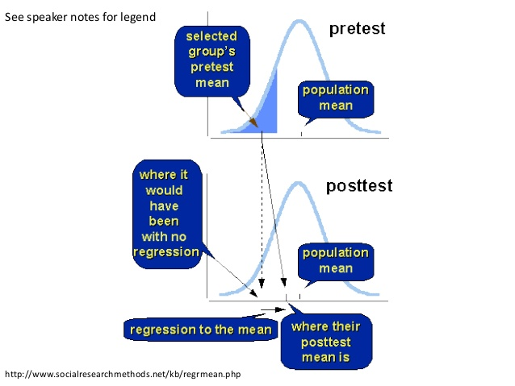

Slide 23
What Does It Depend On?
The absolute amount of regression to the mean depends on two factors:
The degree of asymmetry (i.e., how far from the overall mean of the first measure the selected group's mean is)
The correlation between the two measures

Slide 24
The percent of regression to the mean is:
P_{rm} = 100(1 - r)
Where r is the correlation between the two measures.
If r = 1, there is no (i.e., 0%) regression to the mean.
If r = 0, there is 100% regression to the mean.
If r = 0.2, there is 80% regression to the mean.
If r = 0.5, there is 50% regression to the mean.

Slide 25
Assume a standardized test with a mean of 50.
Pretest
You give your program to the lowest scorers and their mean is 30.
Assume that the correlation of pre-post is 0.5.
30
50
The formula is
P_{rm} = 100(1 - r)
= 100(1-.5)
= 50%
Therefore the mean will regress up 50% (from 30 to 50), leaving a final mean of 40 and a 10 point pseudo-gain.
40
Pseudo-effect
Posttest

Slide 26
Regression Equations through Regression coefficient
In regression analysis there are two types of variables.
The variable whose value is to be predicted is called dependent variable and the variable which is used for prediction is called independent variable.
Regression helps us to estimate the value of one variable, provided the value of the other variable is given.

Slide 27
The regression equation of X on Y is used to describe the variation in the values of X for given changes in Y
The regression equation of Y on X is used to describe the variation in the values of Y for given changes in X.
Case 1: When the actual values are taken
When we deal with actual values of X and Y variables

Slide 28
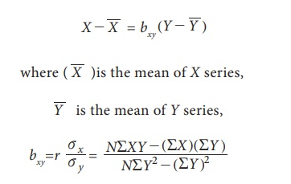
Regression Equation of X on Y
b_{xy} is known as the regression coefficient of X on Y, and r is the correlation coefficient between X and Y, σ_{x} and σ_{y} are standard deviations of X and Y respectively.

Slide 29
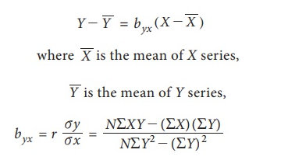

Regression Equation of Y on X
b_{yx} is known as the regression coefficient of X on Y, and r is the correlation coefficient between X and Y, σ_{x} and σ_{y} are standard deviations of X and Y respectively.

Slide 30
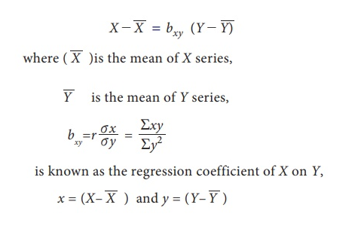
Case 2 Deviations taken from Arithmetic means of X and Y
(i) Regression Equation of X on Y:

Slide 31
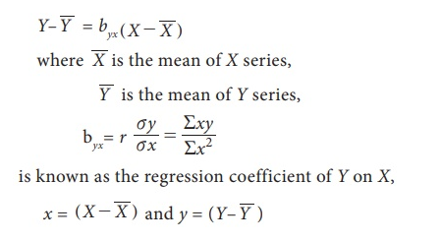
(ii) Regression Equation of Y on X

Slide 32
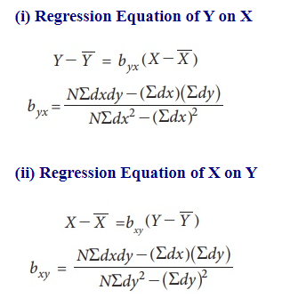
Case 3 Deviations taken from Assumed Mean
When actual means of X and Y variables are in fractions, the calculations can be simplified by taking the deviations from the assumed means.
where dx=X–A, dy=Y–B, A and B are assumed means or arbitrary values are taken from X and Y respectively.

Slide 33

Properties of Regression Coefficients
(i) Correlation Coefficient is the geometric mean between the regression coefficients
(ii) If one of the regression coefficients is greater than unity, the other must be less than unity.
(iii) Both the regression coefficients are of same sign.

Slide 34
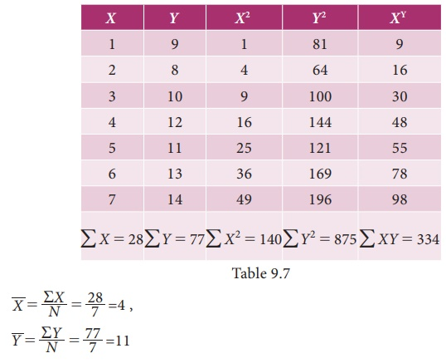

Example
Calculate the regression coefficient and obtain the lines of regression for the following data

Slide 35
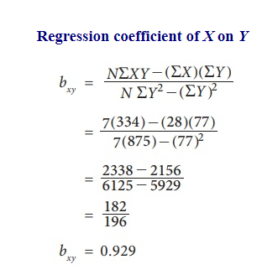
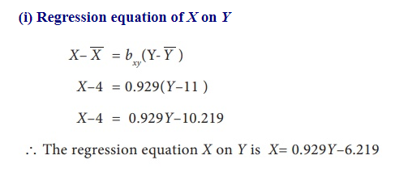

Slide 36
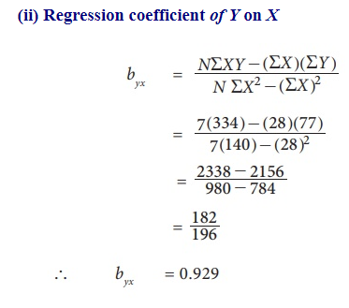
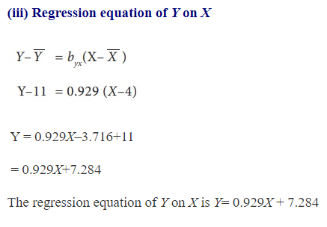

Slide 37

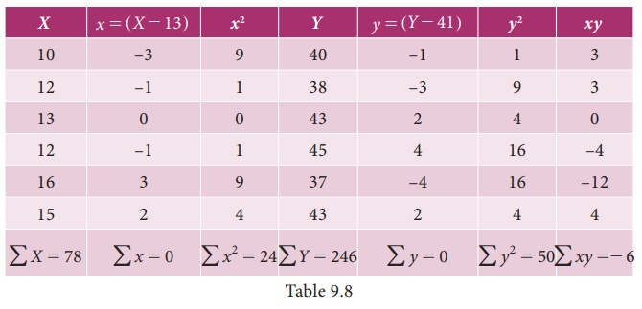
Calculate the two regression equations of X on Y and Y on X from the data given below, taking deviations from a actual means of X and Y.

Slide 38
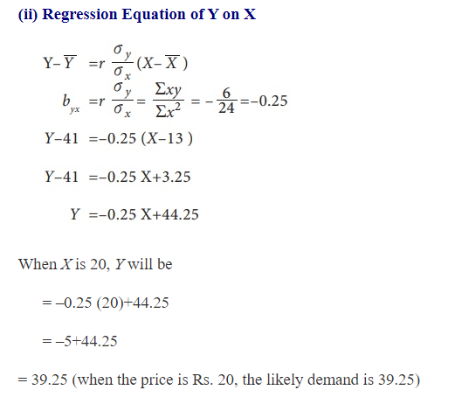
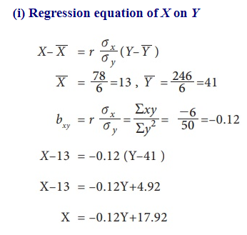

Slide 39
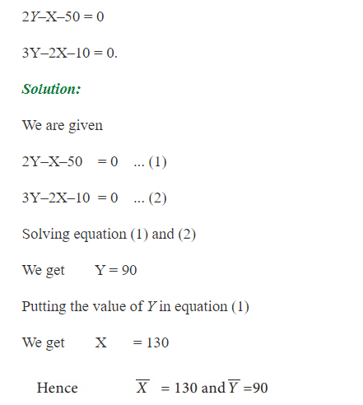
Find the means of X and Y variables and the coefficient of correlation between them from the following two regression equations:

Slide 40
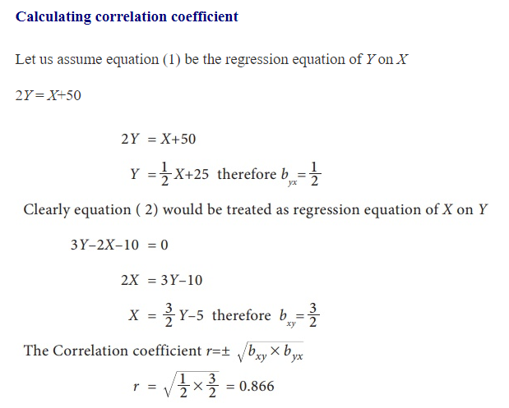
It may be noted that in the above problem one of the regression coefficient is greater than 1 and the other is less than 1. Therefore our assumption on given equations are correct.

Slide 41
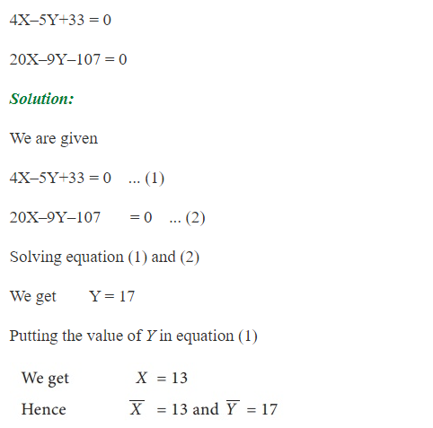
Find the means of X and Y variables and the coefficient of correlation between them from the following two regression equations:

Slide 42
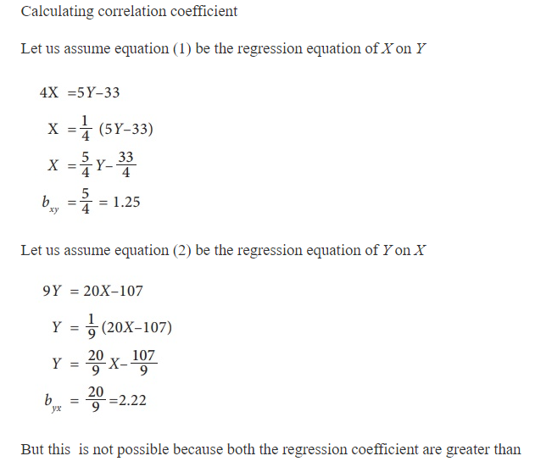

Slide 43
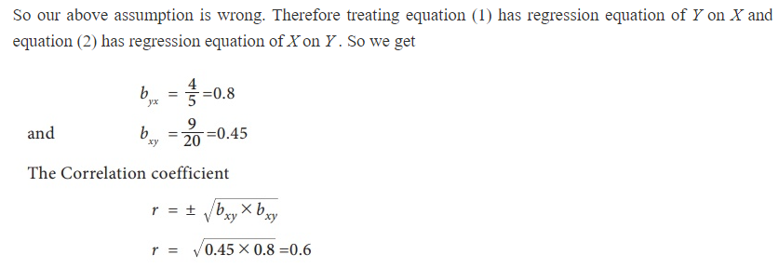

Slide 44
References
https://en.wikipedia.org/wiki/Simple_linear_regression
https://www.investopedia.com/terms/r/residual-standard-deviation.asp
https://www.brainkart.com/article/Regression-Analysis_37035/
https://www.brainkart.com/article/Solved-Example-Problems-for-Regression-Analysis_37036/
Probability & Statistics for Engineers & Scientists by Ronald E. Walpole, Raymond H. Myers, Sharon L. Myers, Keying Ye
PROBABILITY AND STATISTICAL INFERENCE by Robert V. Hogg, Elliot A. Tanis, Dale L. Zimmerman

